Slide 1
Decision Trees and Random Forests

Slide 2

What is a Decision Tree?
Supervised machine learning
Flow chart the machine takes to sort things into categories (making decisions along the way)
For classification

Slide 3
Parts of a Decision Tree
Node – each decision point
Root Node – starting decision point
Edge – The path between nodes
Leaves – Possible outcomes at the end (categories)

Slide 4
What is a Random Forest?
Decision tree on steroids!
Test every combination of nodes to find the best place to put it

Slide 5
Putting it all together…
 | Supervised? | Classifying? | True x and y?
Linear regression | Y | N | Y
K-means | N | N | N
K-nearest neighbors | Y | Y | Y
Decision trees | Y | Y | Y
Random forests | Y | Y | Y

Slide 6
General Steps for Decision Trees & RF
Wrangle the data
Split into training and testing sets
Create the initial model
Assess the fit of the model

Slide 7
Assessing Model Fit

Slide 8
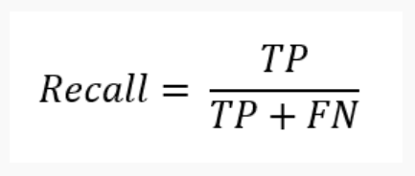
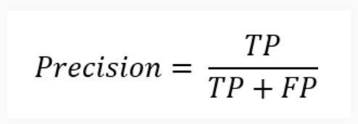
Model Accuracy
Recall
Precision
Ability to find all relevant cases within the dataset
Ability to identify only the relevant data points

Slide 9
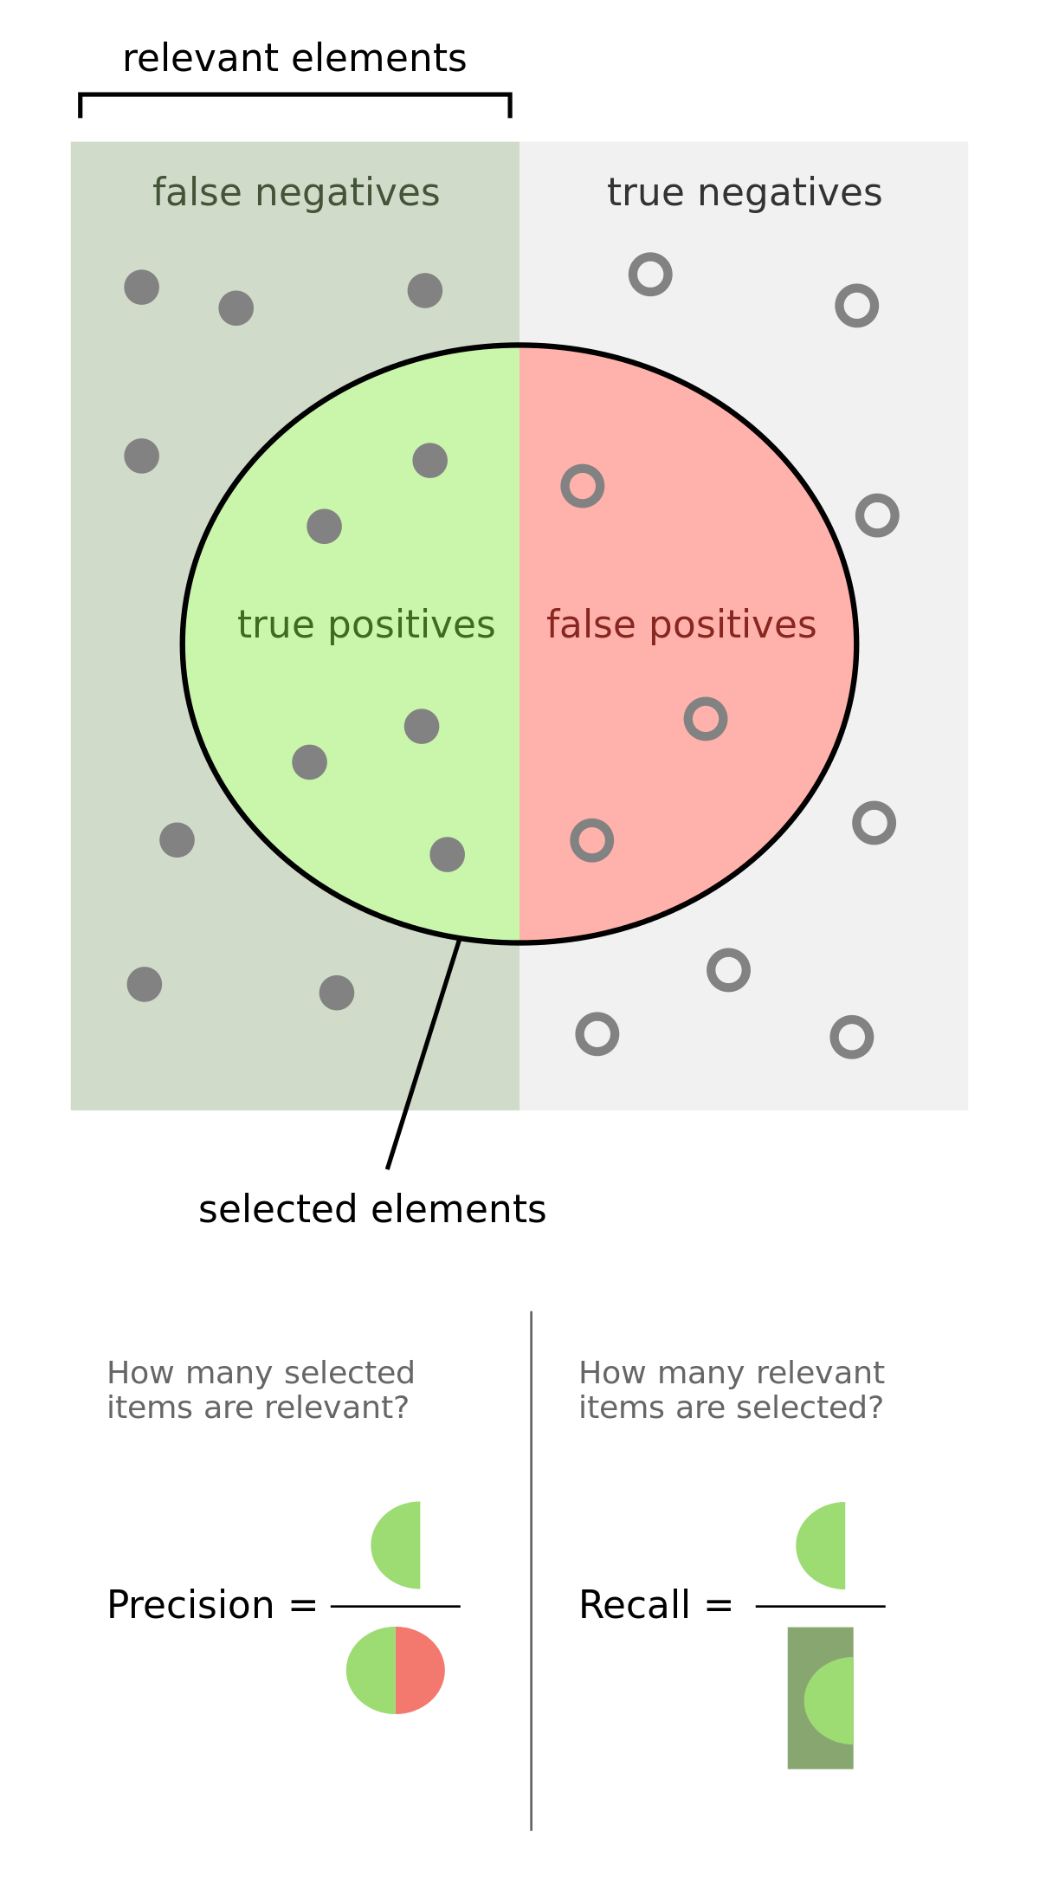
In graphical form…

Slide 10
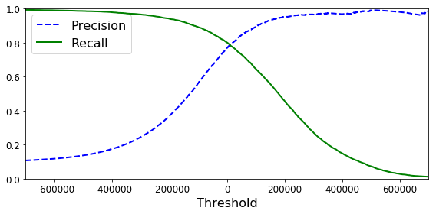
Inversely Related

Slide 11
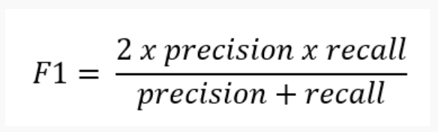
F1 Score
Takes both precision and recall into account

Slide 12
Why are there three?!
Recall – when you can’t afford to miss anything
Disease screening
Terrorists
Precision – when the consequences of mislabeling are high
Administering very expensive treatments
Putting people in prison for life
F1 – when you need a good mix of both

